Slide 1
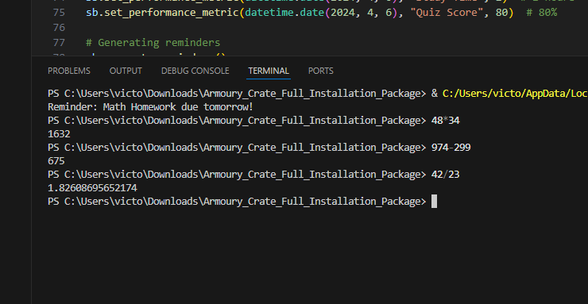
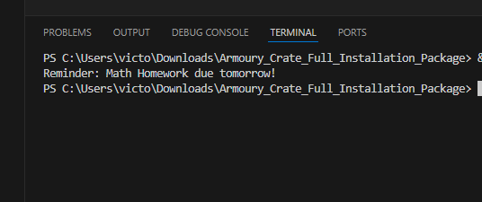
Study Buddy
Unlock Your Math Potential: Personalized Mastery Awaits!
Tailored for students, this Python program offers essential math assistance and a range of features to boost learning. Set reminders, create flashcards, and improve math skills effortlessly for academic success.
Victor To

